Slide 1
How Can a Wellness Technology Company Play It Smart?
N.M.Jinnedi
September 2023

Slide 2
Solution:
Problem:
Analyzing Fitbit fitness tracker data involves six key steps: data collection, cleaning, exploratory (EDA), outliers, similarities & Differences & data analysis. By following these steps, you can uncover correlations, outliers, similarities, and differences within the data. For instance, you can explore the relationship between exercise duration and heart rate, predict fitness outcomes, or identify user behavior patterns for product improvement. This systematic approach helps extract meaningful insights and informs decisions in areas like healthcare, fitness coaching, or product management.
What are some Trends in smart device usage?

Slide 3
Analytical goals
WHY: People are less healthy
HOW: Time people spend in bed awake

Slide 4
Analytical goals
WHY: People are less healthy
HOW: Time people spend in bed awake

Slide 5
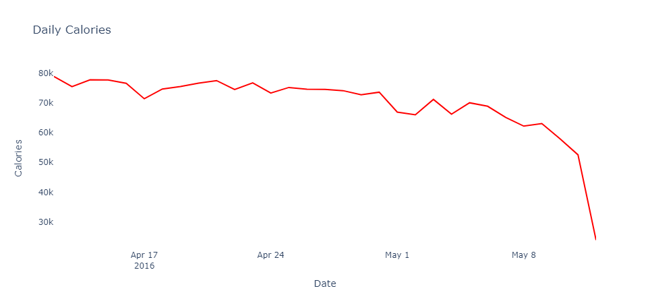
Downward Trend
Burned calories has was constant till 1st May, Then significantly decreased since 5th of May
Source: Data from the FitBit fitness tracker (CC0: Public Domain; made public through Mobius)

Slide 6
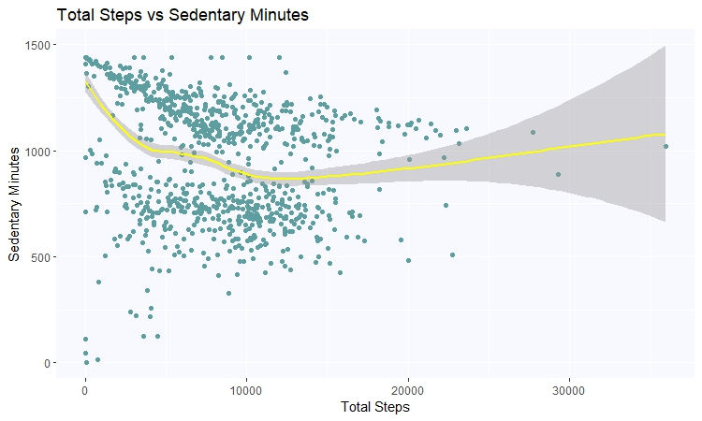
The Reason
The relationship between total steps and sedentary minutes is inverse at first when there are fewer than 10,000 steps done.
Source: Data from the FitBit fitness tracker (CC0: Public Domain; made public through Mobius)

Slide 7
Thus, we need to get people to start moving more and take more steps.

Slide 8
Analytical goals
WHY: People are less healthy
HOW: Time people spend in bed awake

Slide 9
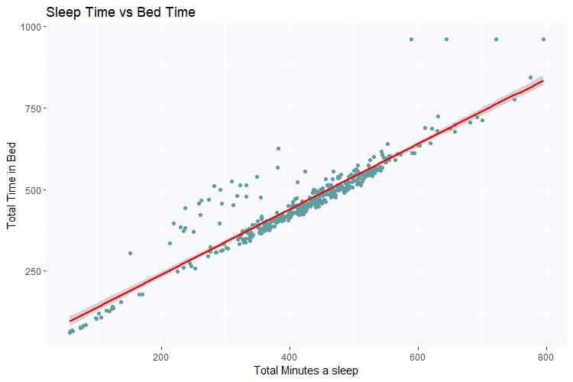
Sleep Time vs Time in Bed
The correlation is approximately 93%
Those who spent a lot of time in bed but didn’t sleep are the outliers.
There may be a variety of causes behind that.
Source: Data from the FitBit fitness tracker (CC0: Public Domain; made public through Mobius)

Slide 10
Thus, we should design our wellness technology to ensure the difference between sleeping in bed and staying awake in bed.

Slide 11
In Summary
WHY: Getting people to start moving more.
HOW: Differentiate between sleeping in bed and staying awake in bed.

Slide 12
Thank You

